Slide 1

Clean Code

Slide 2



Kiedy kod jest „Smell Code”
Spadek
produktywności
Błędy
Brak satysfakcji z pracy

Slide 3
Czas spędzony na kodzie
Czytanie kodu
Pisanie kodu
50%
50%

Slide 4
Czas spędzony na kodzie
Czytanie kodu
Pisanie kodu
80%
20%
Traktuj zły kod jak dług na karcie

Slide 5
“The ratio of time spent reading versus
writing is well over 10 to 1. We are
constantly reading old code as part of
the effort to write new code.”
Robert C. Martin

Slide 6
“...[Therefore,] making it easy to read
makes it easier to write.”
Robert C. Martin

Slide 7


Dla kogo ten kurs
Developers
Test Automation Engineers

Slide 8

Book
Class
Rodział 1
Metoda
Rozdział 2
Zmienne

Slide 9
class CommonManager { // what does this do?
Map<String, String> data; // what kind of data?
public Map<String, String> getData() {
//....
}
Nazewnictwo – łatwo zrozumieć trudniej zrobić

Slide 10
If you misname things, you will
misuse them

Slide 11

Variable naming
Nigdy jedna litera
Zawsze kontretna nazwa
Dwa słowa
Booleans prefix is albo has
camelCase
ALL_CAPS dla stałych

Slide 12
Map<String, String> d = getThings();
Map<String, String> data = getThings();
Map<String, String> passengerDetails = getThings();

Slide 13
Method naming
Powinien ujawnić zamiar
Zawsze kontretna nazwa
2 słowa
Boolean has albo is
Powinna odzwierciedlać co metoda ma robić
Użycie zrozumiałe po nazwie

Slide 14

If you must look inside the
method to understand what it
does – the name needs
improvement

Slide 15
Jak tworzyć nazwy
Czasownik | Rzeczownik | Wynik
load | customerData | loadCustomerData
set | Price | setPrice

Slide 16
getSalesData();
formatSalesData(data);
preCalcSalesData(data);
convertToLocalCurrency(data);
getSalesData(){
// query DB
// format data
// precalculate
}
getAndFormatAndPreCaluculateSalesData()

Slide 17
Naming
Smaller methods
Resuable Code

Slide 19
Classes naming
Rzeczownik
Dzielenie klasy
1-2 słowa

Slide 20
class DayOfWeek {
String MONDAY = “MONDAY”;
String TUESDAY = “TUESDAY”;
// …
}
enum DayOfWeek {
MONDAY,
TUESDAY,
// …
}

Slide 21
Class z statycznym kontentem
enum
Class do przetrzymywania danych
records

Slide 22
class Flight {
Flight(a, b) {}
from();
to();
toString();
hashCode();
//…
}
record Flight(a, b) {
// all boilerplate done for you
}

Slide 23
Daty
LocalDate date = LocalDate.of(2022, null, 10);
Exception in thread "main" java.lang.NullPointerException: month
at java.base/java.util.Objects.requireNonNull(Objects.java:233)
at java.base/java.time.LocalDate.of(LocalDate.java:251)

Slide 24
var thing = new Thing(new A());

Slide 25
var thing = new Thing(new A(), new B(),
new C(), new D());

Slide 26
var thing = Thing.get();

Slide 27
var dbSearch = FlightSearch.newDbSearch();
var apiSearch = FlightSearch.newApiSearch();
var fileSearch = FlightSearch.newFileSearch();

Slide 28
Statyczne Fabryczki
LocalDate.now();
Optional.empty();
String.valueOf(true);
Collections.unmodifiableCollection(...);

Slide 29
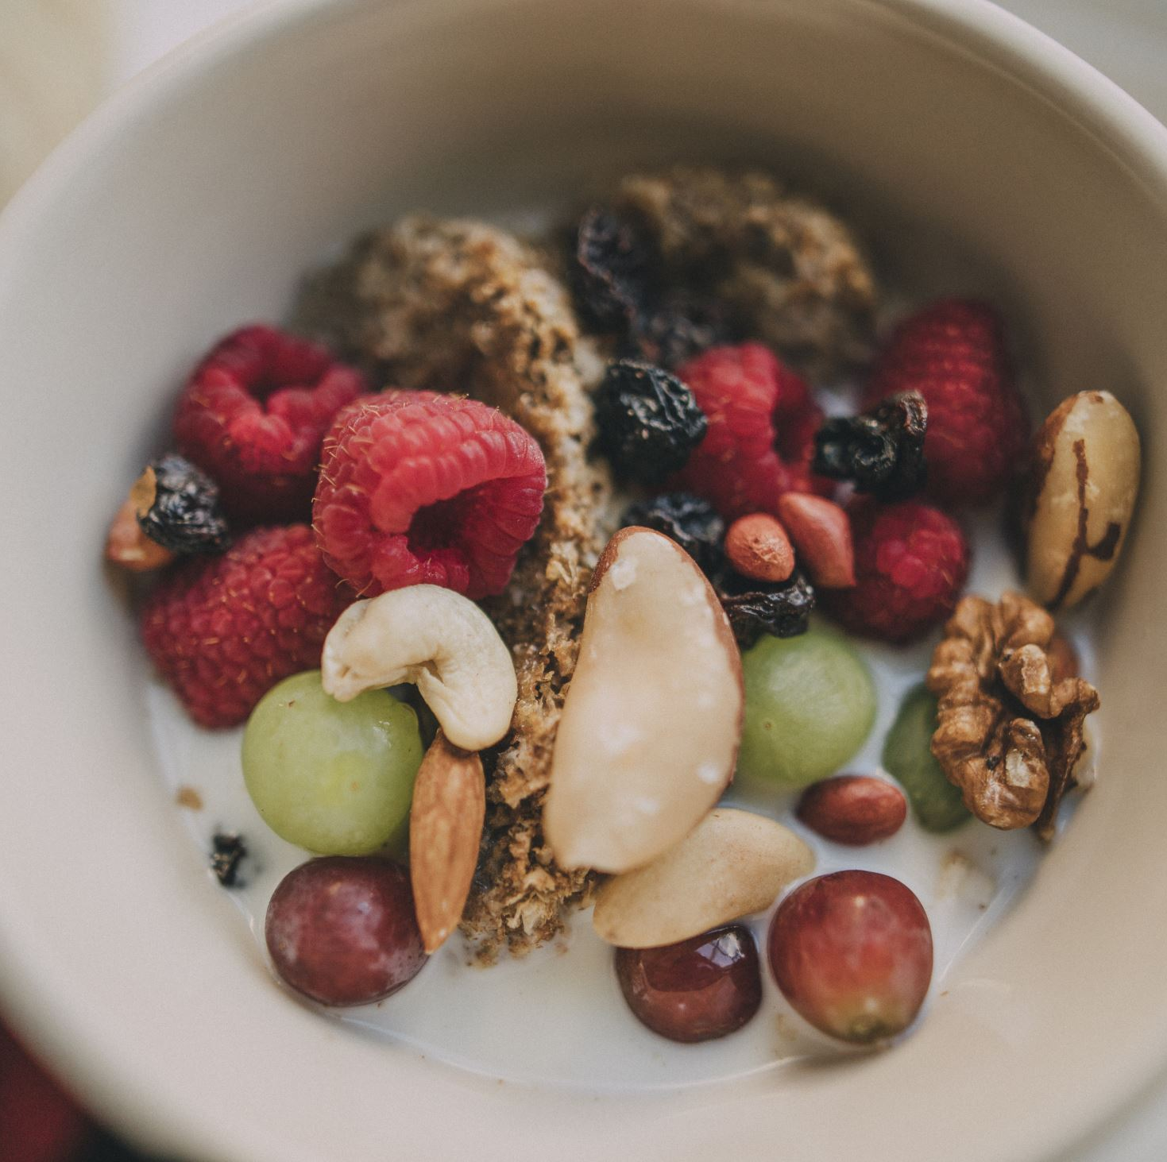
Prymitywy
Co za dużo to nie zdrowo

Slide 30
Teleskopowy konstruktor
Pizza(int size) { ... }
Pizza(int size, boolean cheese) { ... }
Pizza(int size, boolean cheese, boolean ham) { ... }
Pizza(int size, boolean cheese, boolean ham, boolean
mushroom) { ... }

Slide 31
Builder Pattern
Flight flight = FlightBuilder()
.from(“NYK”)
.to(“LDN”)
.capacity(150)
.build();

Slide 32
Methody implementacja
public List<Flight> search(a, b, c){
// check input
// implementation
// return
}

Slide 33
Metoda implementacja
Methods should do one thing
Avoid too many parameters
Flag arguments are a poor choice
Prefer enums over strings
Fail fast principle in methods
Useful concepts for local vars
What to return, and what not to return

Slide 34
Ile parametrów ?

Slide 35
Generally, fewer parameters is better.

Slide 36
Ilość paramterów
OK | Unikaj | Refactor now !!!
0-2 | 3 | 4+

Slide 37
Metdy plus size
Do too many things (split it)
Take too many primitive types (pass a single
object)
Takes a boolean (flag) argument

Slide 38
“Flag arguments are ugly.
It immediately complicates the signature of
the method, loudly proclaiming that this
function does more than one thing.”
Robert C. Martin

Slide 39
var flights = getFlights();
String var name; // no improvement
BufferedReader var reader = new BufferedReader(...); // yes!

Slide 40
Zwracamy
Prymitywy
Obiekty
Null
Nigdy nie zwracaj null !!!!!
Nidy nie zwracaj -1,0

Slide 41

Magia
Zmusić do zrozumienia co się robi
Rezultat jest nie jasny

Slide 42
// resulting balance is -1?
// or does -1 have a special meaning?
if(withdraw(100) == -1) {
}

Slide 43
Null
Throw
Default
Pusta kolekcja
Optional

Slide 45
String
String name = "James";
String s = "Name: " + name;
String s2 = String.format("Name: %s", name);
New strings - new objects

Slide 46
String str = "";
for (int i = 0; i < stringArr.length ; ++i) {
str = str + stringArr[i];
}
StringBuilder sb = new StringBuilder();
for (int i = 0; i < stringArr.length; ++i) {
sb.append(stringArr[i]);
}
String str = sb.toString();

Slide 47
Block text
String json = """
[
{
"from":"New York",
"to":"London",
"date":"2022-07-07"
}
]
""";
String json = "[\n" +
" {\n" +
" \"from\":\"New York\",\n" +
" \"to\":\"London\",\n" +
" \"date\":\"2022-07-07\"\n" +
" }\n" +
"]";

Slide 48
Separtory
int num = 100;
int num2 = 1000000; // million?
int num3 = 1_000_000; // million!

Slide 49
Typy złożone
class Money {
BigDecimal amount;
Currency currency;
}

Slide 50



Boolean
if (!gateClosed == false)
if (!gateClosed)
if (!isGateClosed)
if (isGateOpen)

Slide 51
Zmień warunek na metode

Slide 52
If (check)
Else {throw}
Else {throw}

Slide 53
Prefer streams

Slide 54
for (int i = 0; i < someList.size(); i = i + 2) {
// ...
}
for (int num: someList) {
// ...
}

Slide 55
words.collect(
groupingBy(word -> word.chars().sorted()
.collect(StringBuilder::new,
(sb, c) -> sb.append((char) c),
StringBuilder::append).toString()))
.values().stream()
.filter(group -> group.size() >= minGroupSize)
.map(group -> group.size() + ": " + group)
.forEach(System.out::println);

Slide 56

Wyjątki
File file = new File(“file.txt”);
try (var inputStream = new FileInputStream(file)) {
// read
} catch (IOException e) {
log.error(e);
}

Slide 57

File file = new File(“file.txt”);
FileInputStream stream;
try {
// read
} catch (FileNotFoundException e) {
e.printStackTrace();
} catch (Throwable e) {
// should never happen
}

Slide 59

S.O.L.I.D

Slide 60
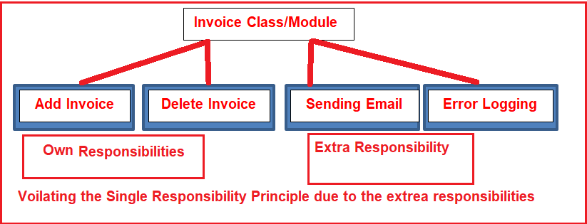
Single Responsibility (SRP)
Klasa ma tylko jeden cel

Slide 61
Open Closed (OCP)
Otwarta na rozwijanie (Open for extsion)
Zamknięta na modyfikacje (Close for modification)

Slide 62
Open Closed (OCP)
Closed for modification
Open for change

Slide 63
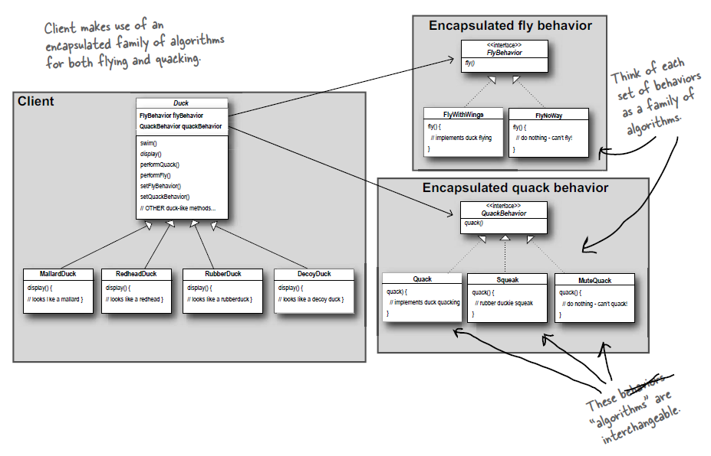
OCP

Slide 64

Listcov Substitution Prinicple (LSP)

Slide 65
Interface Segregation Principale
Interface
Interface
Interface
Class
Interface
Class
Interface
Interface

Slide 66
Dependecies Invertion (DIP)

